Slide 1
Image classification- fashion mnist
Jayavani Akkiraju
50442863
Srujana Golconda

Slide 2
Outline
Problem specification
Dataset description
Data pre-processing and Visualization
State-of-the-art algorithms
Accuracy results of train and test data
Model Comparisons
Conclusion

Slide 3
Problem Specification
The Fashion-MNIST dataset is a collection of Zalando's article images.
It contains 60,000 training examples and 10,000 test examples. There are 10 classes represented by 28x28 grayscale images.
For benchmarking machine learning algorithms, Zalando intends to replace MNIST with Fashion-MNIST.
In both training and testing, the size and structure of the images are the same.

Slide 4
Dataset Description
Each image has 28 pixels in height and 28 pixels in width, totaling 784 pixels. Using pixel values, each pixel is assigned a value indicating its lightness or darkness, with higher numbers indicating a darker pixel.
Pixel-values range from 0 to 255. There are 785 columns in the training and test data sets.
Clothing articles are represented in the first column by class labels.
Other columns contain the associated image's pixel values.

Slide 5
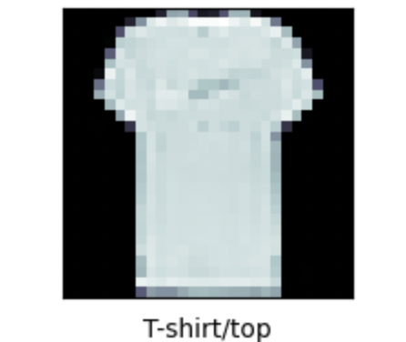
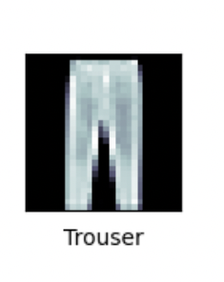
Dataset Description
Labels
Each training and test example is assigned to one of the following labels:
0 T-shirt/top 1 Trouser

Slide 6
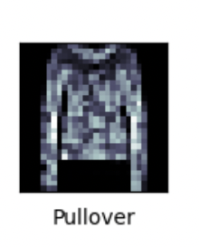
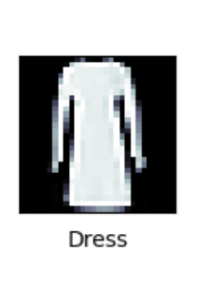
Dataset Description
Labels
2. Pullover 3. Dress

Slide 7
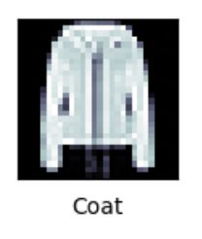
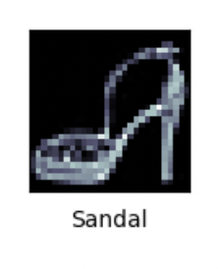
Dataset Description
Labels
4. Coat 5. Sandal

Slide 8
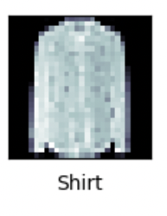
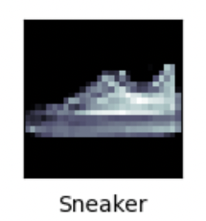
Dataset Description
Labels
6. Shirt 7. Sneaker

Slide 9
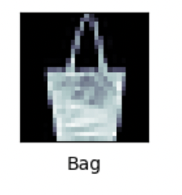
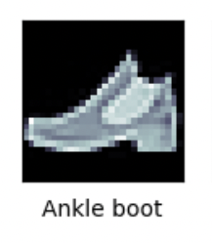
Dataset Description
Labels
8. Bag 9. Ankle boot

Slide 10
Dataset Description
There are separate images for each row
The class label is column1
Remaining columns are pixel numbers (784 total).
The value of each pixel is its darkness (1 to 255)
Original dataset was downloaded from \https://github.com/zalandoresearch/fashion-mnist
Dataset was converted to CSV with this script
\https://pjreddie.com/projects/mnist-in-csv/

Slide 11
License
The MIT License (MIT) Copyright © [2017] Zalando SE, https://tech.zalando.com
Permission is hereby granted, free of charge, to any person obtaining a copy of this software and associated documentation files (the “Software”), to deal in the Software without restriction, including without limitation the rights to use, copy, modify, merge, publish, distribute, sublicense, and/or sell copies of the Software, and to permit persons to whom the Software is furnished to do so, subject to the following conditions:
The above copyright notice and this permission notice shall be included in all copies or substantial portions of the Software.
THE SOFTWARE IS PROVIDED “AS IS”, WITHOUT WARRANTY OF ANY KIND, EXPRESS OR IMPLIED, INCLUDING BUT NOT LIMITED TO THE WARRANTIES OF MERCHANTABILITY, FITNESS FOR A PARTICULAR PURPOSE AND NONINFRINGEMENT. IN NO EVENT SHALL THE AUTHORS OR COPYRIGHT HOLDERS BE LIABLE FOR ANY CLAIM, DAMAGES OR OTHER LIABILITY, WHETHER IN AN ACTION OF CONTRACT, TORT OR OTHERWISE, ARISING FROM, OUT OF OR IN CONNECTION WITH THE SOFTWARE OR THE USE OR OTHER DEALINGS IN THE SOFTWARE.

Slide 12
Data Preprocessing
We initially split the training and test data by their labels and predictors.
We check for the null values. As there are no null values in the data we proceed with the data as is.
Reshaping the data to 28*28 matrix of pixels.
Normalization
Pixel values range from 0 to 256, apart from 0, the range is 255.
By dividing all the values by 255, we get a range from 0 to 1.

Slide 13
Data Preprocessing
To Categorical
A class vector (integers) is converted to a binary class matrix.
The labels of train and test data is converted to a binary class matrix.
The label range is 0-9 as there are 10 labels in the given data.
Once the preprocessing is done, we proceed with the model fitting on the train data.

Slide 14
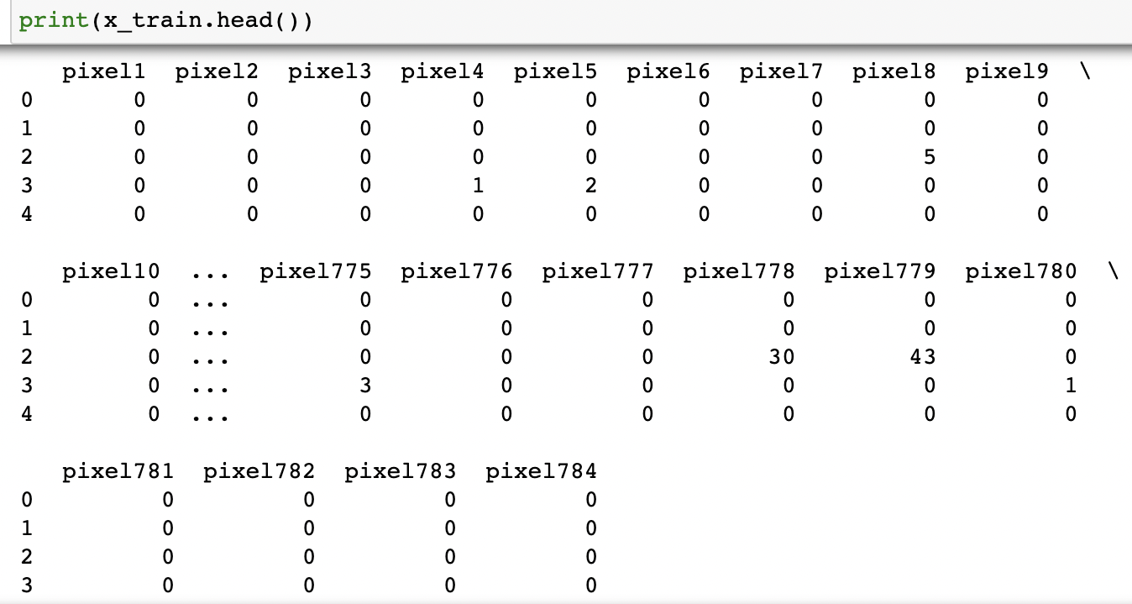
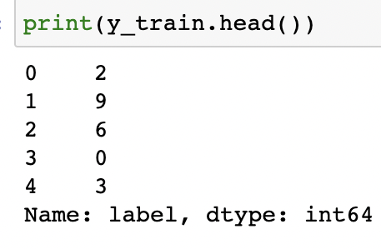
Data Visualization
head()
Using the Pandas head() method, we can retrieve the top n
rows of a data frame or series.

Slide 15
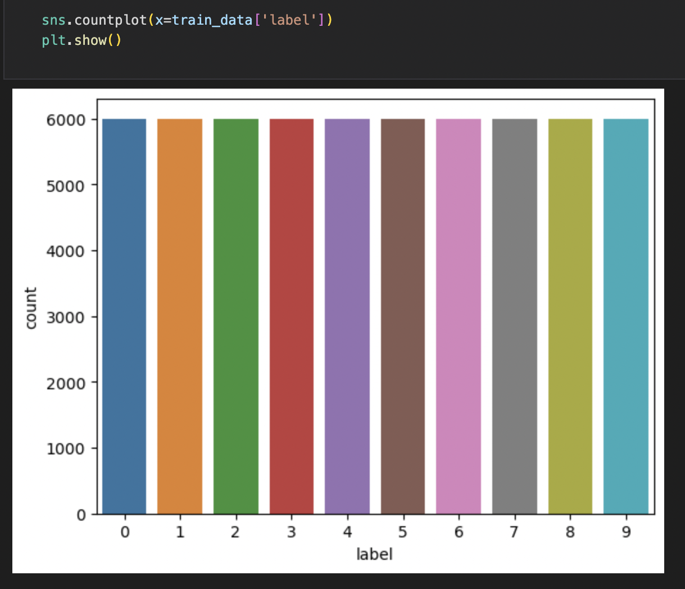
Countplot of train Data
A plot of each label showing their count in the train data.
Each label is present 6000 times in the data.

Slide 16
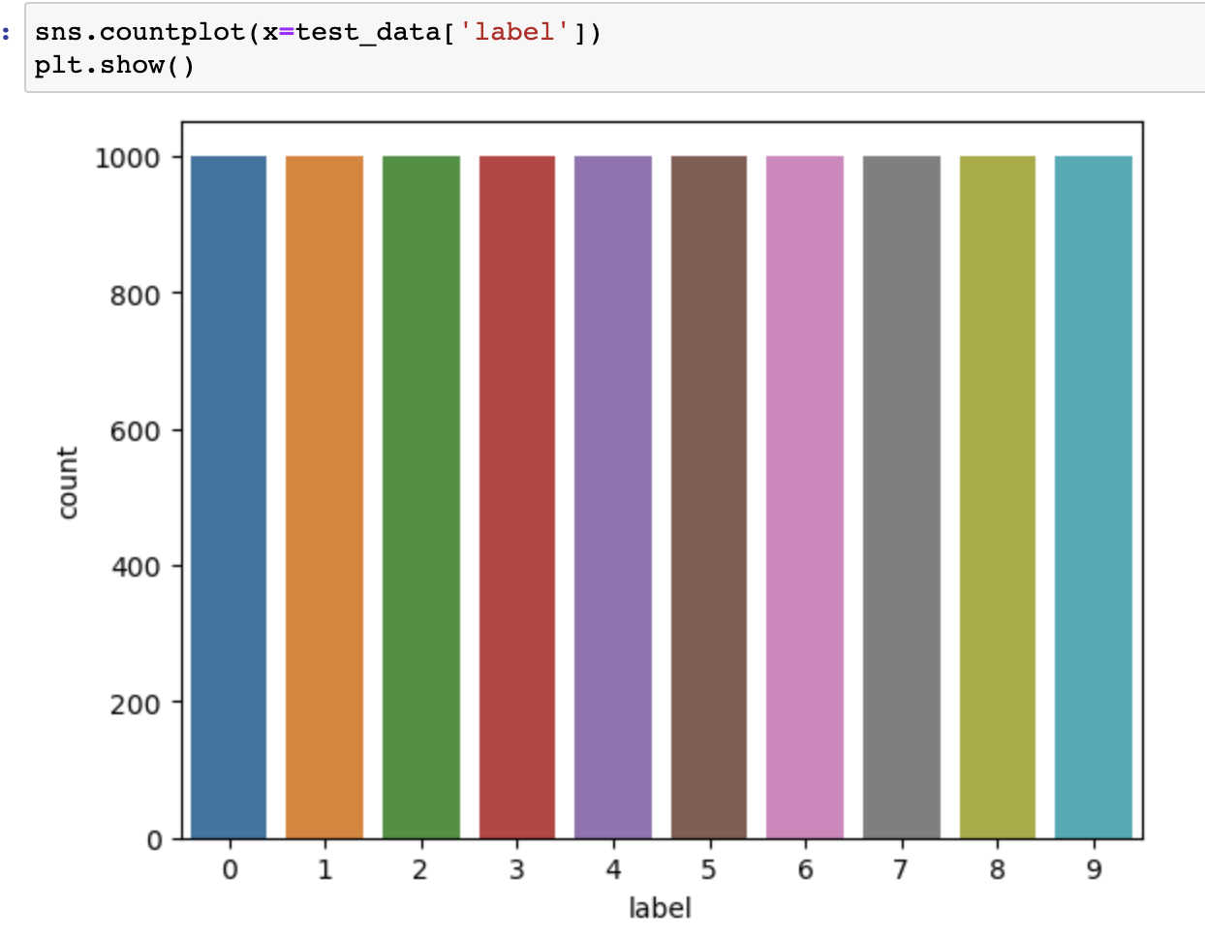
Countplot of test Data
A plot of each label showing their count in the test data.
Each label is present 1000 times in the data.

Slide 17
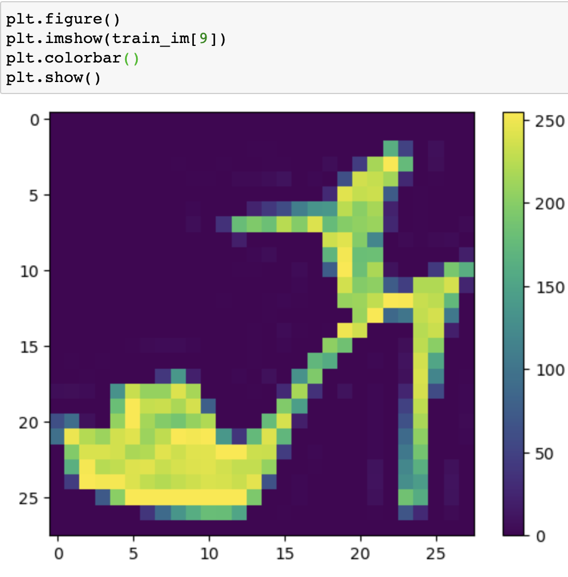
Plot showing an image at particular index of the train data along with its pixels value range.

Slide 18
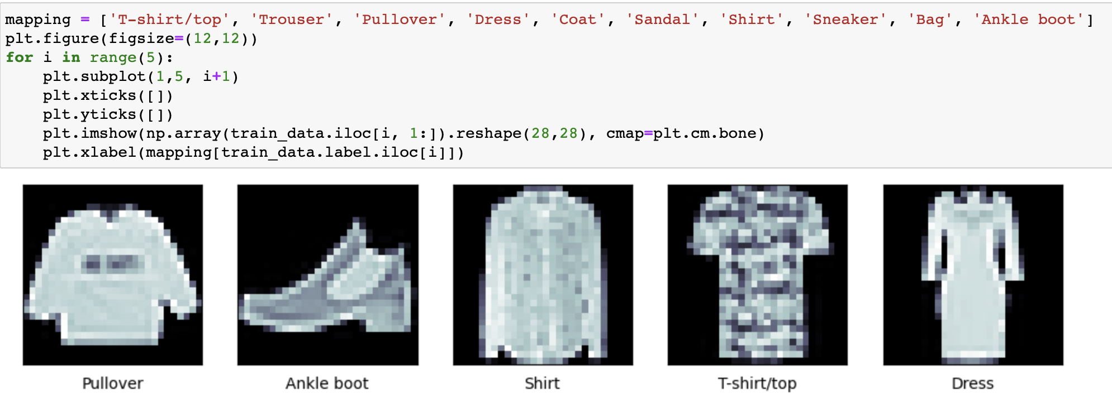
Plotting the image with label
Displaying a few images with their labels of the train data.

Slide 19
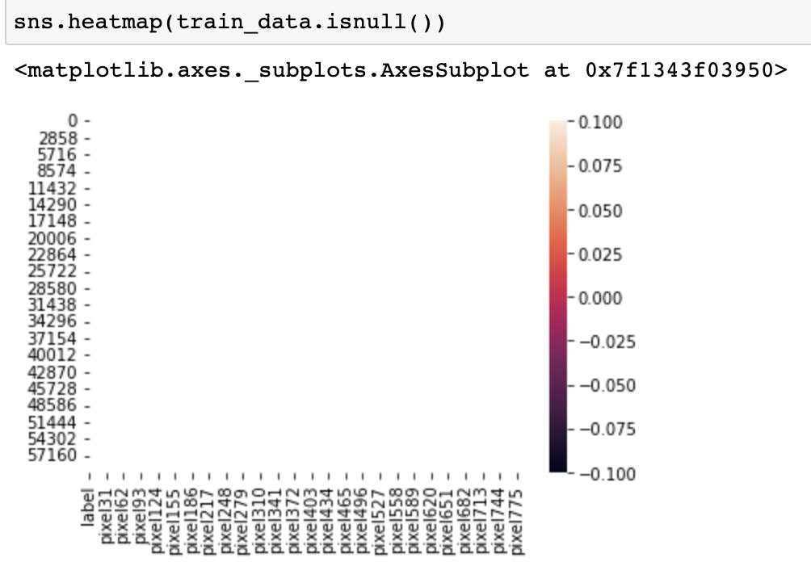
Heatmap
Checking if there are any null values in the data using a heatmap.

Slide 20
State-of-the-art algorithms
1. PCA and KNN
PCA:
It is often difficult to interpret large datasets like fashion MNIST. PCA (Principal Component Analysis) reduces the dimensionality of such datasets, improving interpretability while minimizing information loss. By successively maximizing variance, it creates new uncorrelated variables. By solving the eigenvalue/eigenvector problem, such new variables, the principal components, can be found, and these new variables may be determined by the dataset.

Slide 21
PCA
Initially, we import train and test data.
Calculating variance from standard deviation along the column of the train data of predictors.
Reshaping train and test data using variance.
Converting train and test label data into binary class.
Fitting the PCA model on to the train data to reduce the dimensionality of the data.
Retrieve cumulative sum.
Fitting KNN along with PCA in the end.

Slide 22
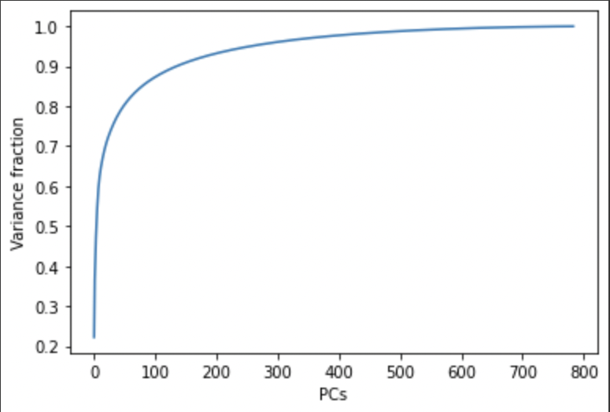
Plotting variance ratio vs principal components

Slide 23
Studies and examples seem to reduce down to 32 dimension embeddings (with fairly large starting states, like this image), but the number can be somewhat arbitrary.
32 features captures 76% of the variance as per the PCs and variance fraction.
We tried building the KNN model by changing the number of nearest neighbors and identified a slight change in the accuracy of model on the test data.
Also, changing the number of components produces a slightly different result on the test data.

Slide 24
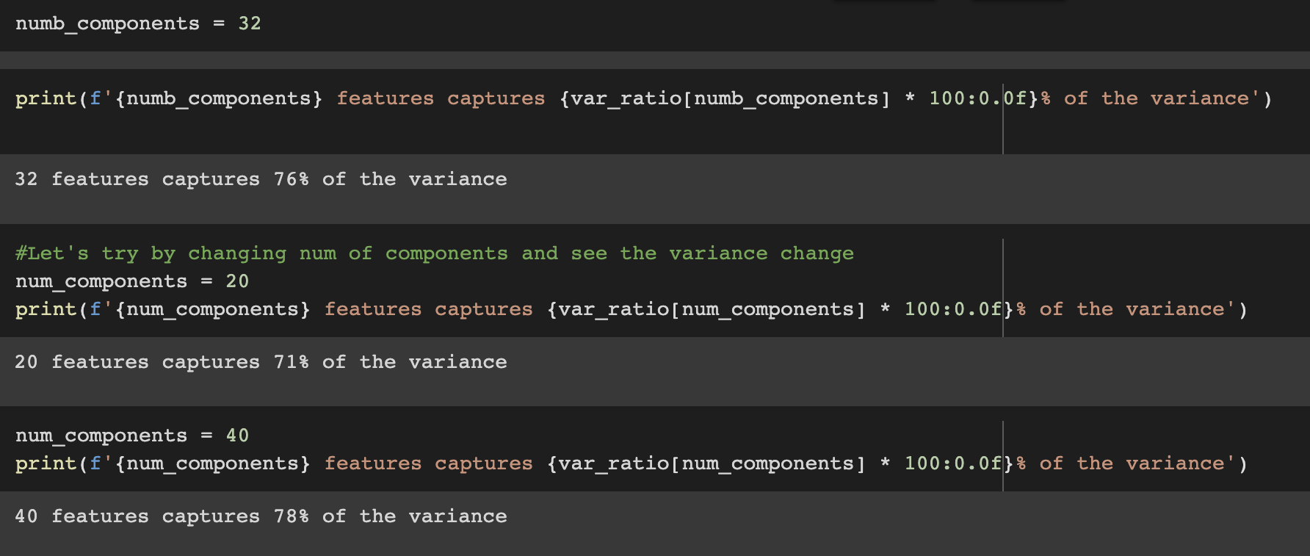
Number of components and variance

Slide 25
KNN
KNN is a non-parametric, supervised learning algorithm that predicts how individual data points are grouped based on proximity. The algorithm can be applied to both regression and classification problems, but is most commonly used for classifying points based on their similarity.
A majority vote is used to assign class labels. Data points are labeled according to their most common association.
The K value represents the number of nearest neighbors
KNN is instance-based.

Slide 26
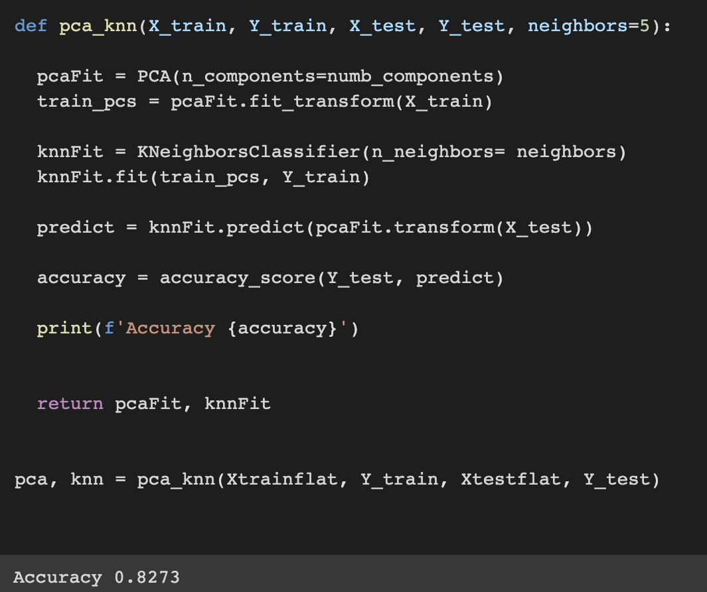
KNN
Building PCA KNN model with 5 nearest neighbors.
Accuracy : 82.7%.

Slide 27
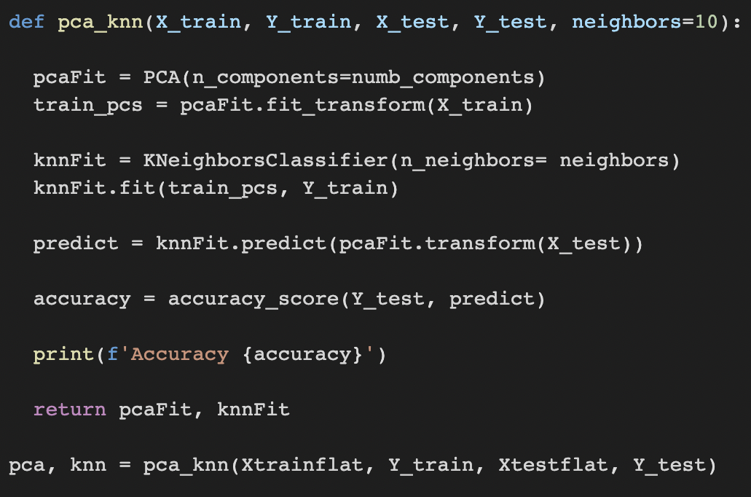
PCA + KNN
Building PCA KNN model with 10 nearest neighbors.
Accuracy: 79.7%.

Slide 28
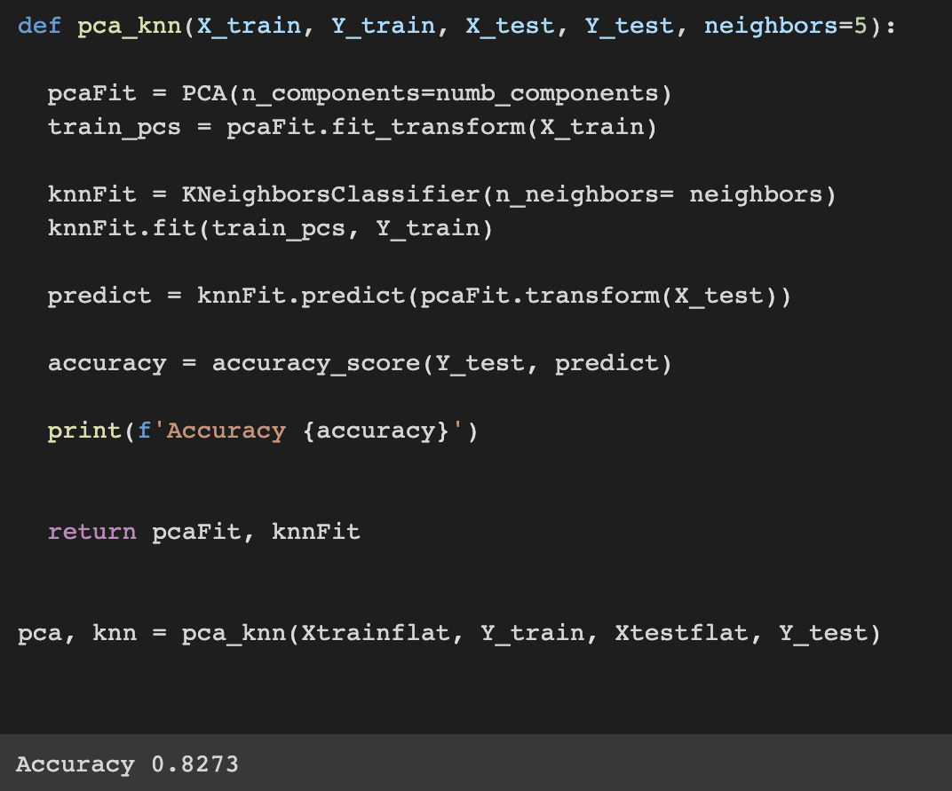
PCA + KNN
Building PCA KNN model with 5 nearest neighbors, 32 components
Accuracy: 82.7%.

Slide 29
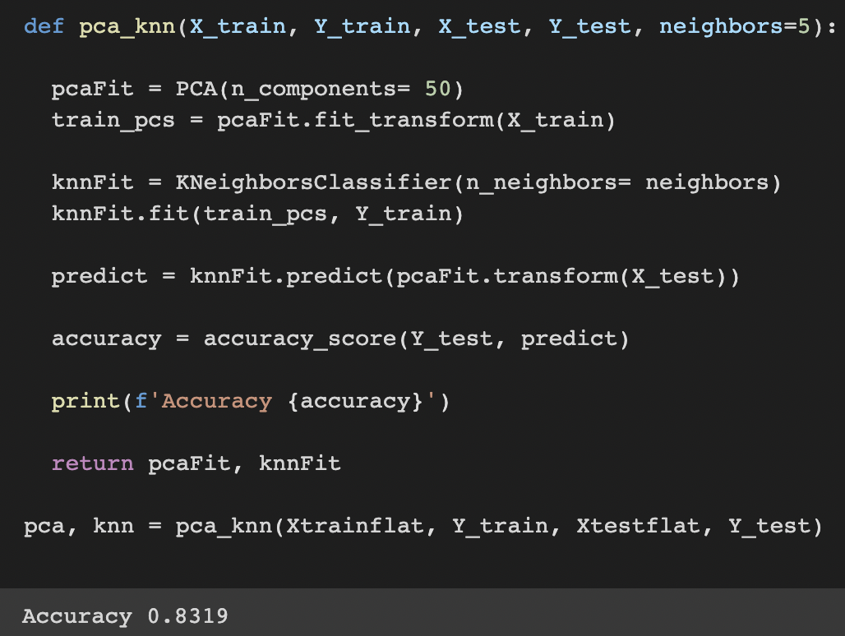
PCA + KNN
Building PCA KNN model with 5 nearest neighbors, 50 components
Accuracy: 83.19%.

Slide 30
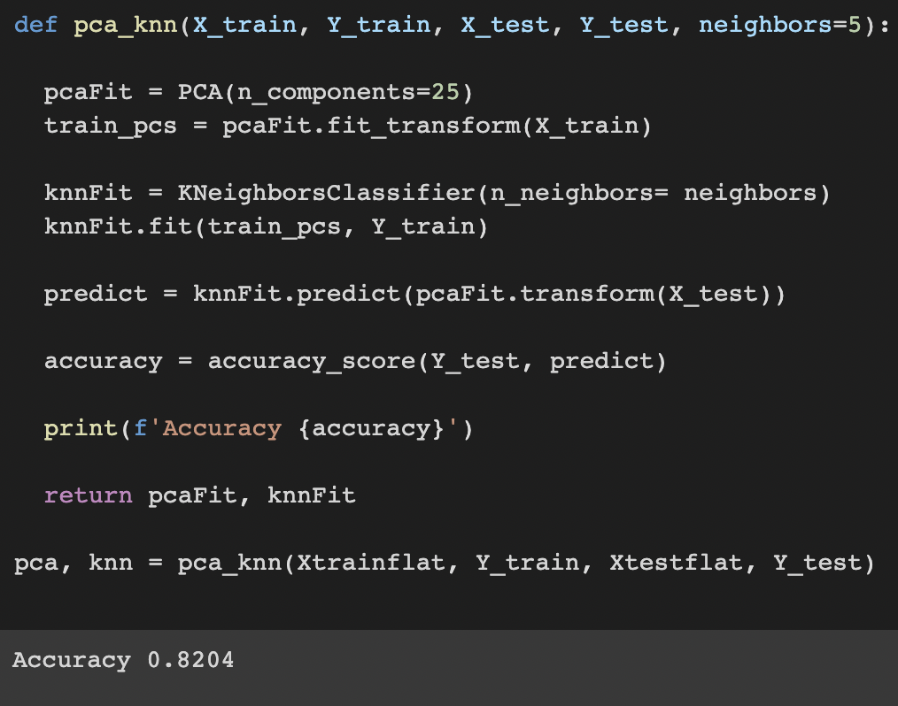
PCA + KNN
Building PCA KNN model with 5 nearest neighbors, 25 components
Accuracy: 82%.

Slide 31
Neural Network
Using neural networks, a computer learns to perform a task by analyzing training examples. Initial weights and thresholds of a neural network are set to random values during training.
It passes through successive layers, being multiplied and added in complex ways, before finally arriving at the output layer, transformed. During training, weights and thresholds are continuously adjusted to produce similar results on training data with the same labels.

Slide 32
Neural Network
A neural network is built up of layers. Representations are derived from the data fed into the layers.
In this network, the first layer, tf.keras.layers.Flatten, transforms images from two-dimensional arrays (28 by 28 pixels) into one-dimensional arrays (28 by 28 pixels).
After the pixels are flattened, the network has a sequence of two tf.Keras.layers.Dense layers.
There are two types of neural layers: densely connected and fully connected.

Slide 33
Compile the model
Before the model is trained, it needs a few more things. These are added during the model's compile step:
Loss function —This measures the accuracy of the model during training. We need to minimize the loss function for the best model.
Optimizer —The model gets updated based on the data it sees and its loss function using an optimizer.
Metrics — Monitors training and testing steps.

Slide 34
Train the model
Fit the training data onto the model.
The model learns the images based on the predictors.
Model being asked to make predictions on the test set.
Verify the predictions match the labels of the actual test set.

Slide 35
Neural Network
Model 1 :
First Dense Layer : 64 neurons/nodes
Second Dense Layer (Output) : returns a logit array with length of 10.
As there are 10 labels (0-9) output is 10 here in the second dense layer.
Activation : relu
Optimizer : Adam
Loss function: SparseCategoricalCrossentropy
Epochs = 15
Test Accuracy : 87.8%

Slide 36
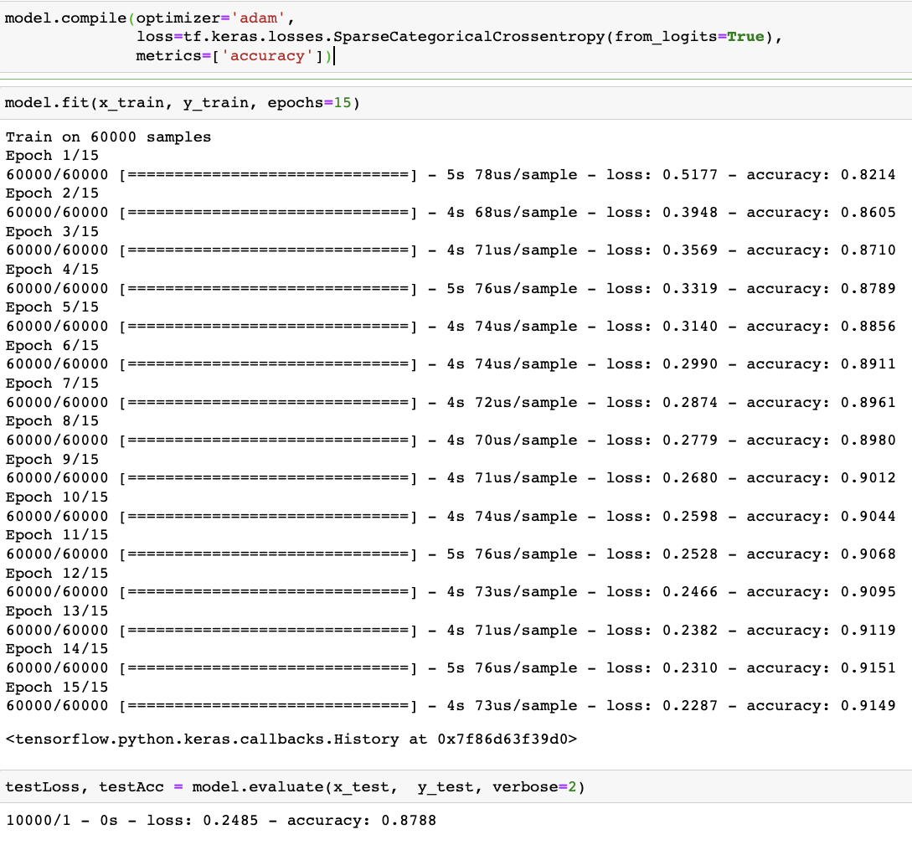
Model 1

Slide 37
Neural Network
Model 2 :
First Dense Layer : 128 neurons/nodes
Second Dense Layer (Output) : returns a logit array with length of 10.
As there are 10 labels (0-9) output is 10 here in the second dense layer.
Activation : relu
Optimizer : Adam
Loss function : SparseCategoricalCrossentropy
Epochs = 12
Test Accuracy : 88.7%

Slide 38
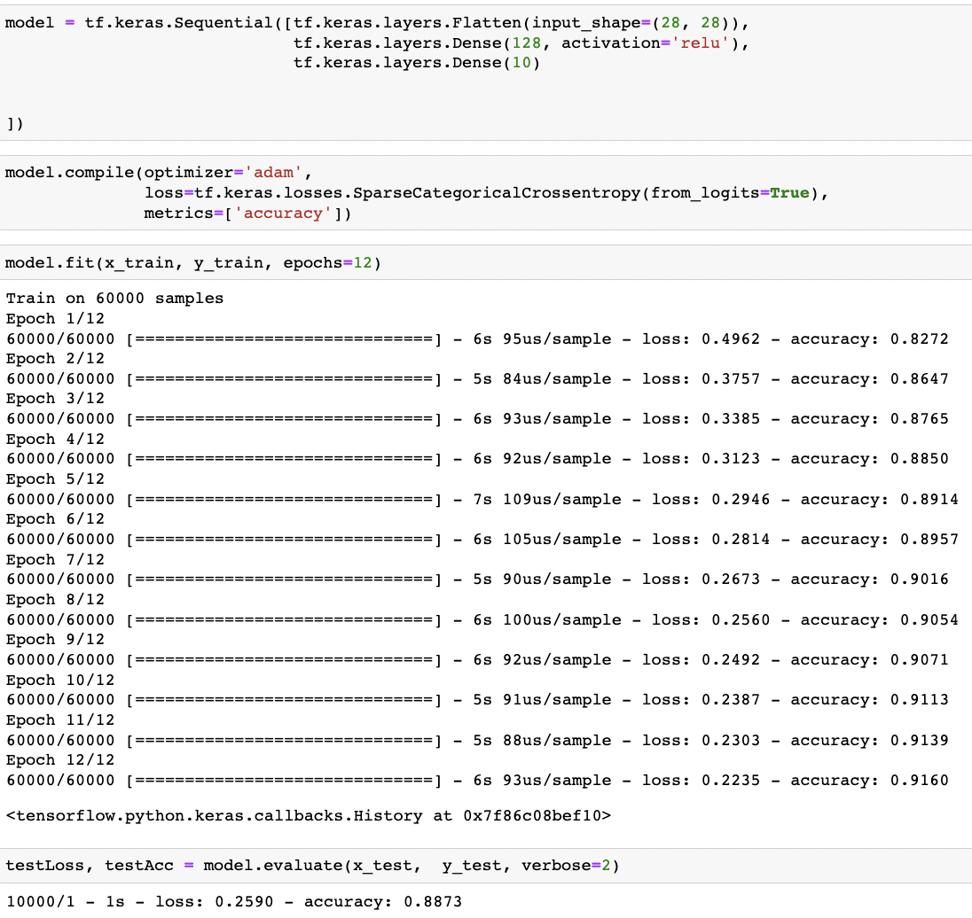
Model 2

Slide 39
Neural Network
Model 3 :
First Dense Layer : 128 neurons/nodes
Second Dense Layer (Output) : returns a logit array with length of 10.
As there are 10 labels (0-9) output is 10 here in the second dense layer.
Activation : relu
Optimizer : sgd
Loss function : SparseCategoricalCrossentropy
Epochs = 10
Test Accuracy : 89.6%

Slide 40
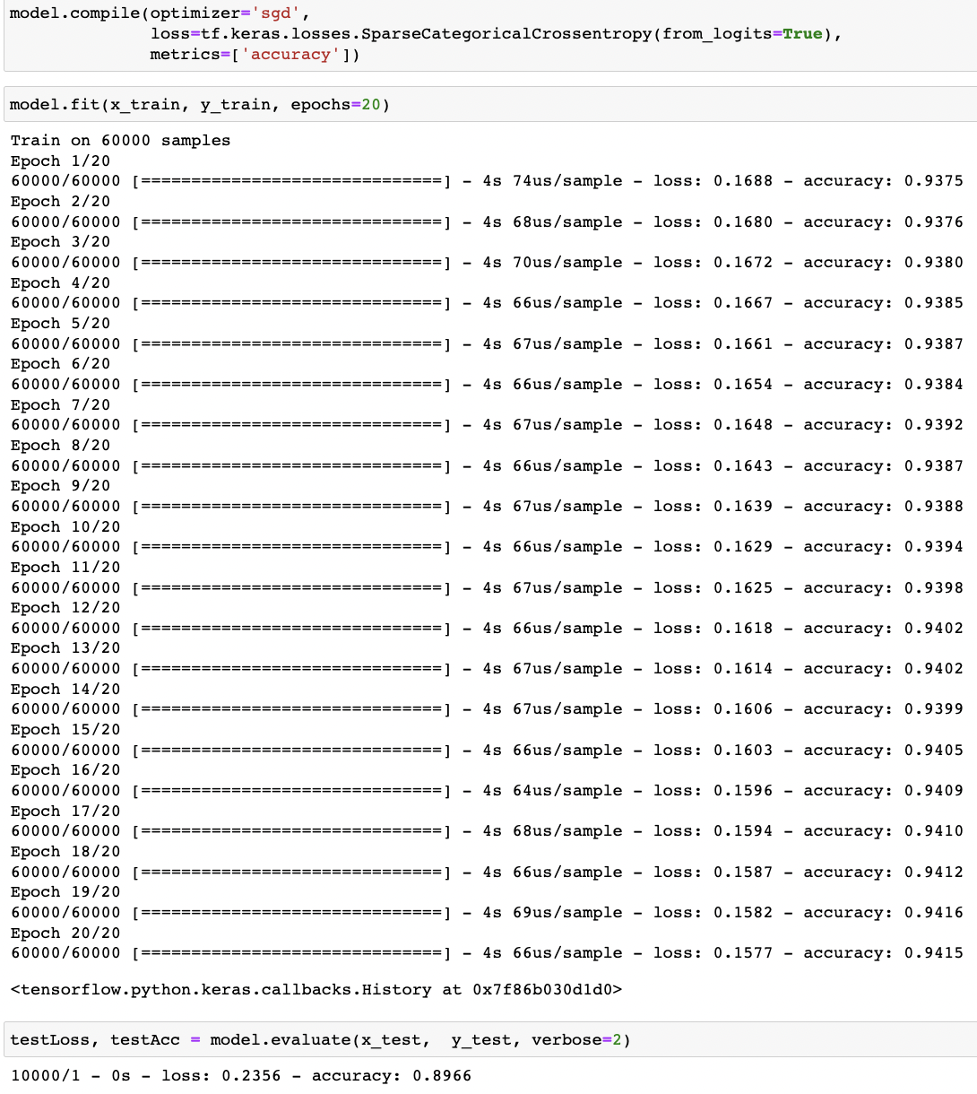
Model 3

Slide 41
Observation
In all the three models seen above, it turns out that the accuracy on the test dataset is a little less than the accuracy on the training dataset.
This gap between training accuracy and test accuracy represents overfitting.
Overfitting happens when a machine learning model performs worse on new, previously unseen inputs than it does on the training data. An overfitted model "memorizes" the noise and details in the training dataset to a point where it negatively impacts the performance of the model on the new data.

Slide 42
CNN
A CNN (convolutional neural network) is a kind of network architecture for deep algorithms and is mainly used for image recognition and tasks that involve the processing of pixel data.
The CNN is another type of neural network that can uncover key information in both time series and image data
A deep learning CNN consists of three layers:
A convolutional layer, a pooling layer and a fully connected (FC) layer. The convolutional layer is the first layer while the FC layer is the last.

Slide 43
CNN
model = sequential()
A sequential model is appropriate for a plain stack of layers where each layer has exactly one input tensor and one output tensor.
Applying a 2D convolution over an input signal composed of several input planes (32, 64, 128).
Applying a Max pooling operation for 2D spatial data.
A Dense layer of 256 neurons.
A Dense layer (Output) of 10 neurons which is the output layer.

Slide 44
CNN
Initializing the model:
Activation = 'relu' for Conv2D and Dense layers.
For the output layer, apply the 'softmax' activation function.
Compiling the model:
Optimizer = 'adam'
loss='categorical_crossentropy'
Accuracy:
Test data Accuracy is 90.93%.

Slide 45
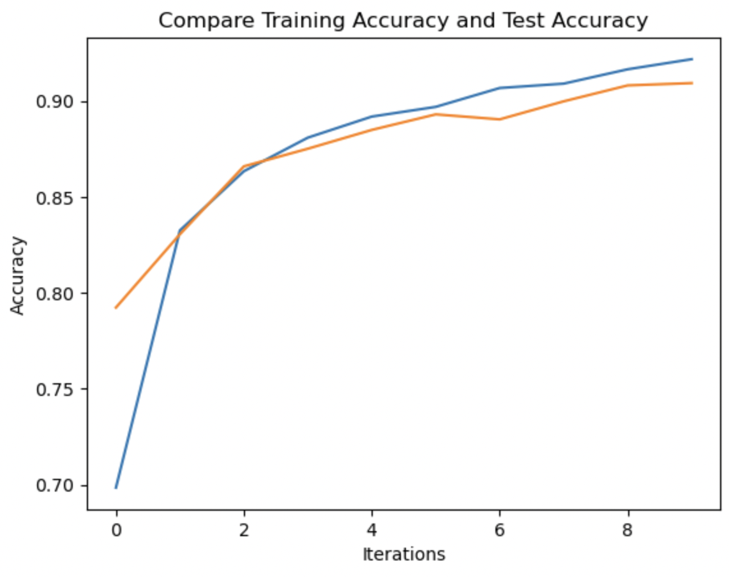
CNN
Training Accuracy vs Test Accuracy

Slide 46
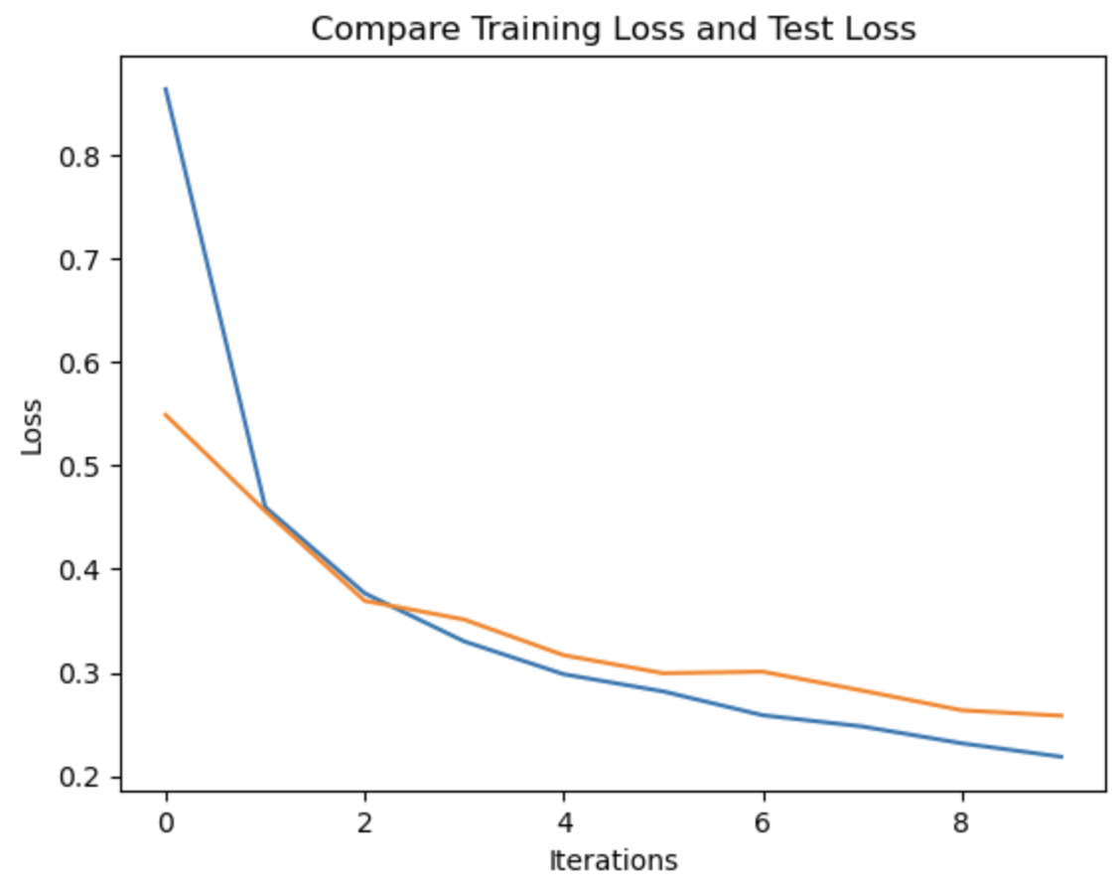
CNN
Training loss vs Test loss

Slide 47
EarlyStopping
Too much training will mean that the model will overfit the training dataset and have poor performance on the test set.
There is a slight overfitting on train data leading to change in train vs test accuracies.
Early stopping is an optimization technique used to reduce overfitting without compromising on model accuracy.
The main idea behind early stopping is to stop training before a model starts to overfit.

Slide 48
Early Stopping
Layers:
Conv2D(32, 64)
MaxPooling2D(pool_size = 2)
Dropout(0.04)
Conv2D(128)
Dropout(0.02)
Dense(256)
Dense(10)

Slide 49
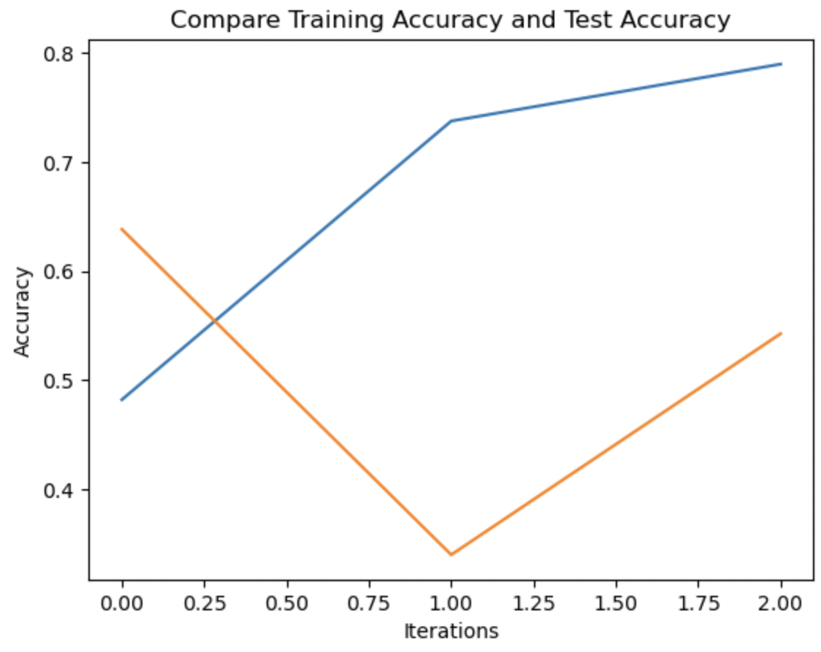
EarlyStopping

Slide 50
Zero Padding
In convolutional neural networks, zero-padding refers to surrounding a matrix with zeroes. This can help preserve features that exist at the edges of the original matrix and control the size of the output feature map.
Zero padding occurs when we add a border of pixels all with value zero around the edges of the input images.
By using Zero Padding in the model, we obtained the test accuracy as :
86.9%.

Slide 51
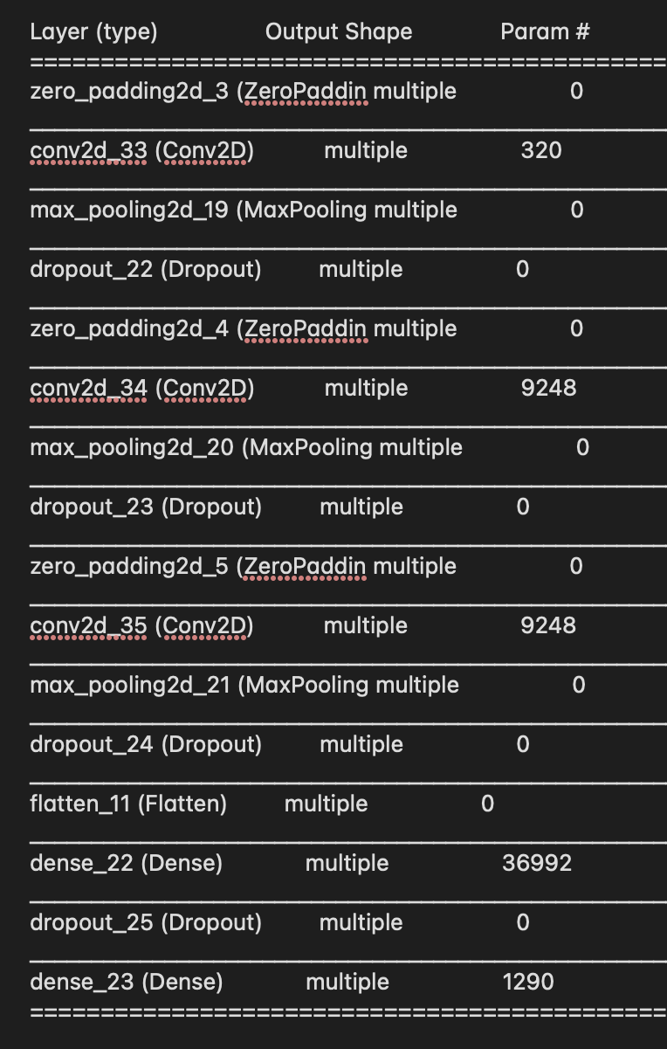
CNN
Zero Padding:

Slide 52
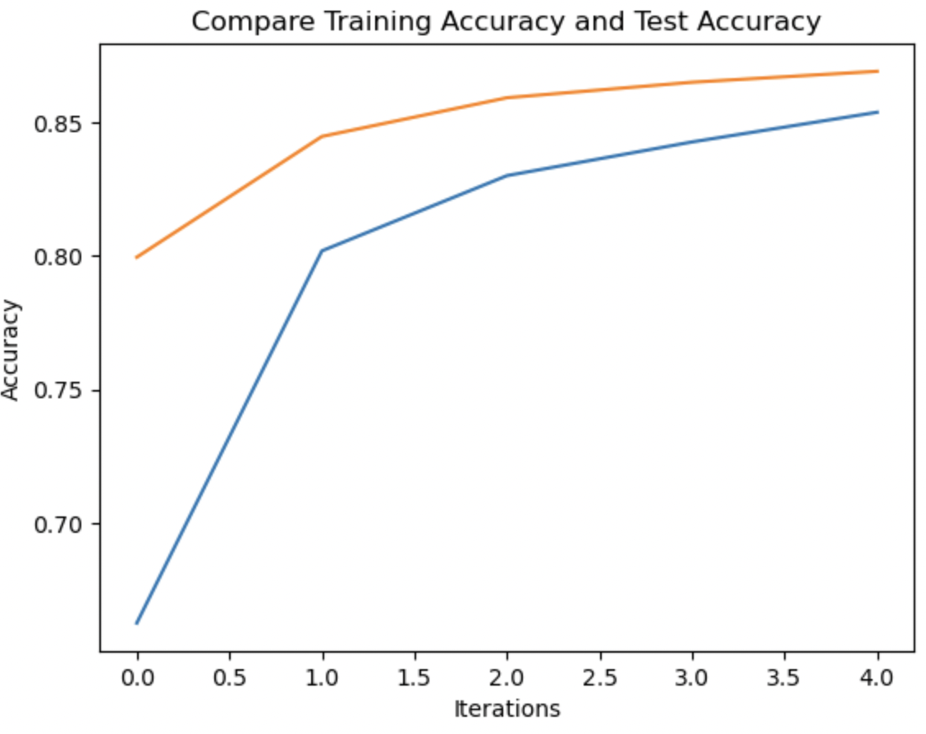
Zero Padding

Slide 53
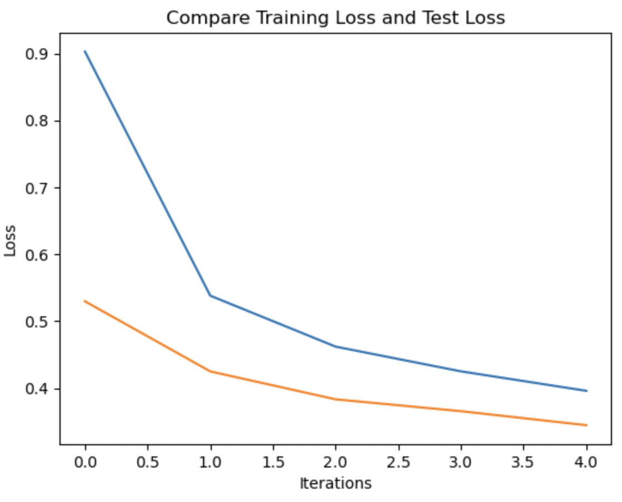
Zero Padding

Slide 54
Dropout
During a neural network, "dropouts" refer to units (both visible and hidden) dropping out.
The term dropout refers to ignoring units (i.e. neurons) during the training phase of a random set of neurons.
When passing forward or backward, these units are not considered.
Edges connected to a dropped-out node are also removed.

Slide 55
Dropout
Dropout – 0.001
Layers:
Conv2D(32) ; Conv2D(64)
MaxPooling2D(pool_size=2))
Dropout(0.001)
MaxPooling2D(pool_size=2))
Conv2D(128)
Dropout(0.001)
Dense(256) ; Dense(10)

Slide 56
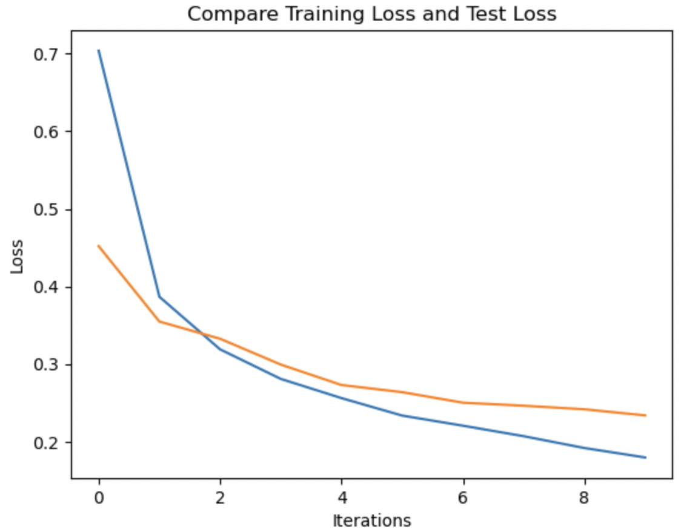
Dropout

Slide 57
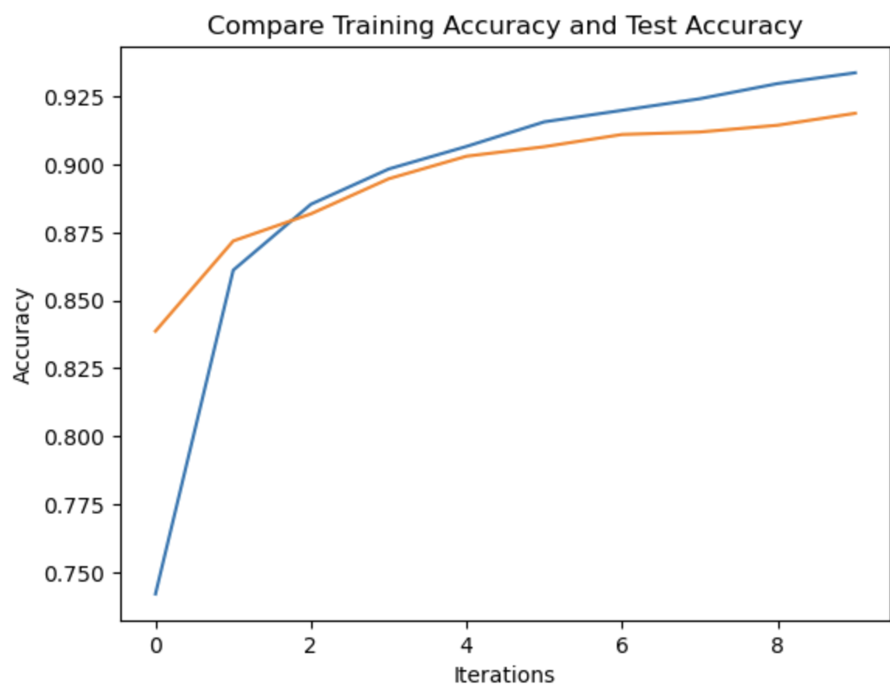
Dropout

Slide 58
Dropout
Dropout – 0.005
Layers:
Conv2D(32) ; Conv2D(64)
MaxPooling2D(pool_size=2))
Dropout(0.005)
MaxPooling2D(pool_size=2))
Conv2D(128)
Dropout(0.005)
Dense(256) ; Dense(10)

Slide 59
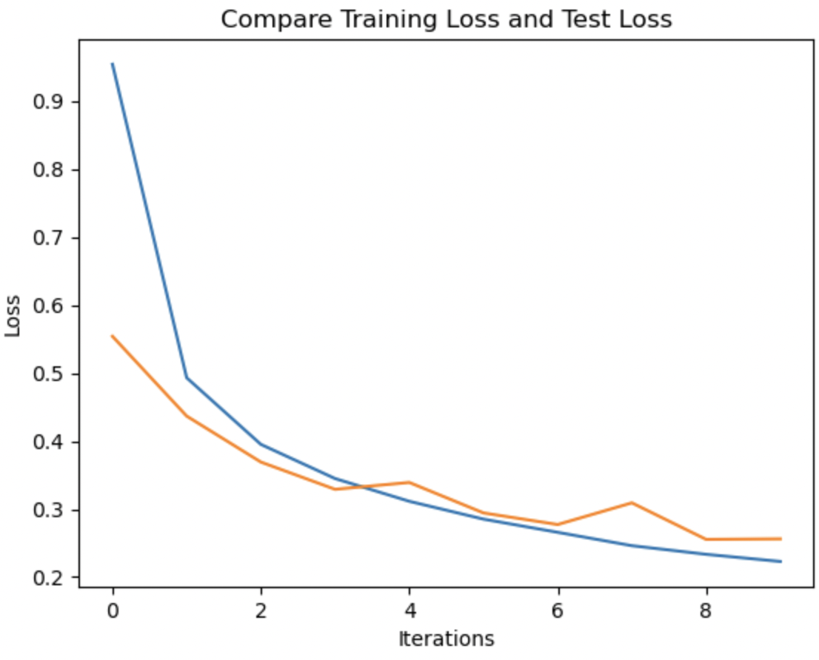
Dropout

Slide 60
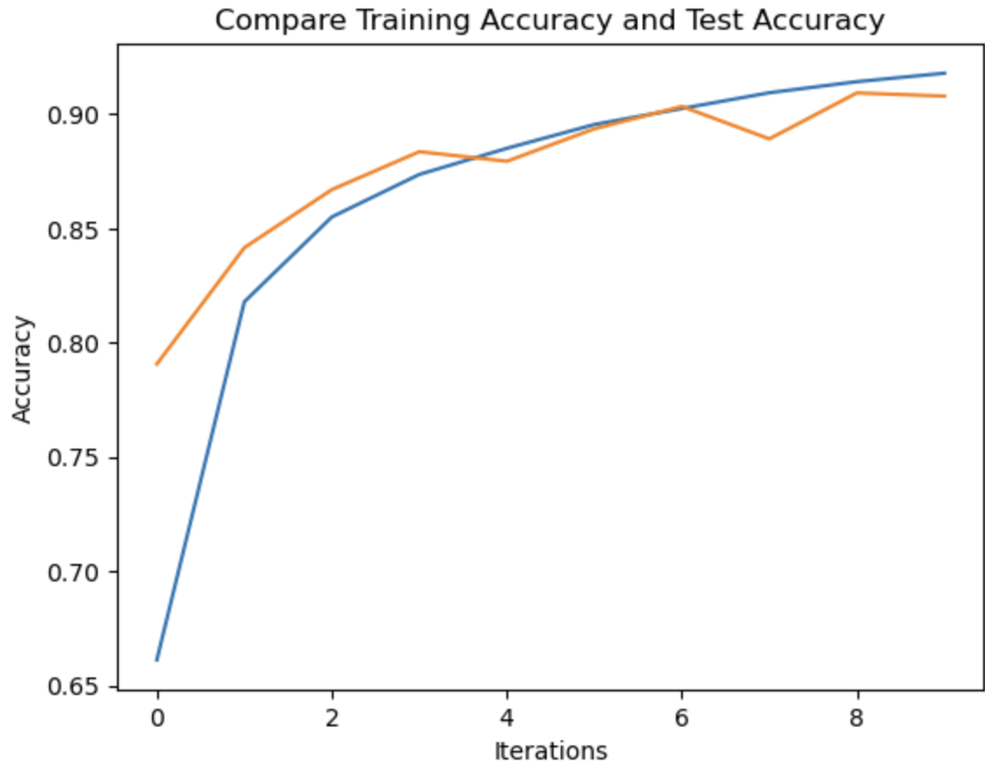
Dropout

Slide 61
Dropout
Technique | Percentage | Test Accuracy
Dropout | 0.1 | 91.89 %
Dropout | 0.5 | 90.79%

Slide 62
Optimizer
Model:
Optimizer = Adadelta
loss='categorical_crossentropy
Epoch = 10
Batch_size = 1000
Activation = relu
Activation = softmax ( Output layer)

Slide 63
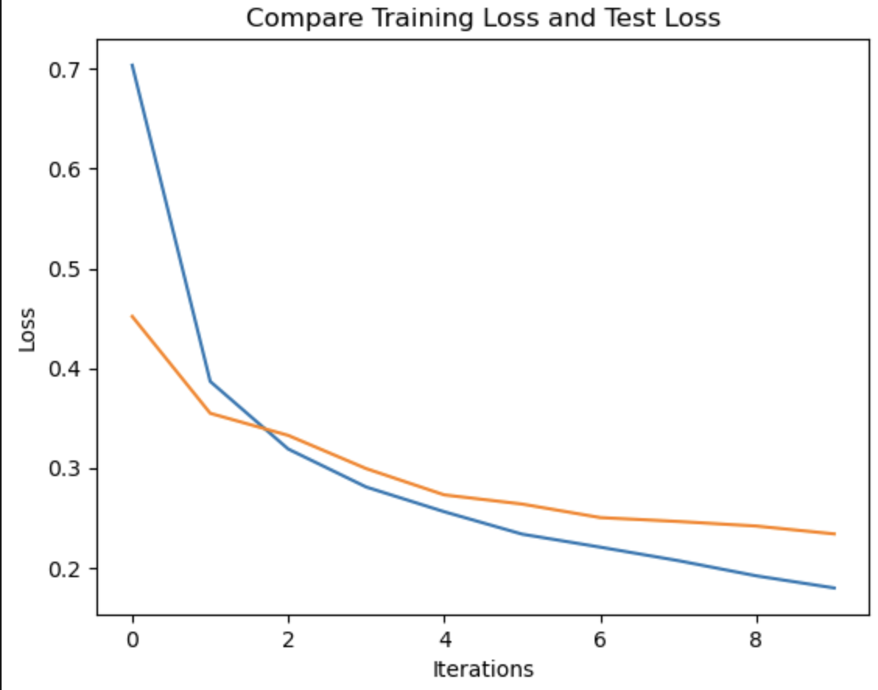
Optimizer

Slide 64
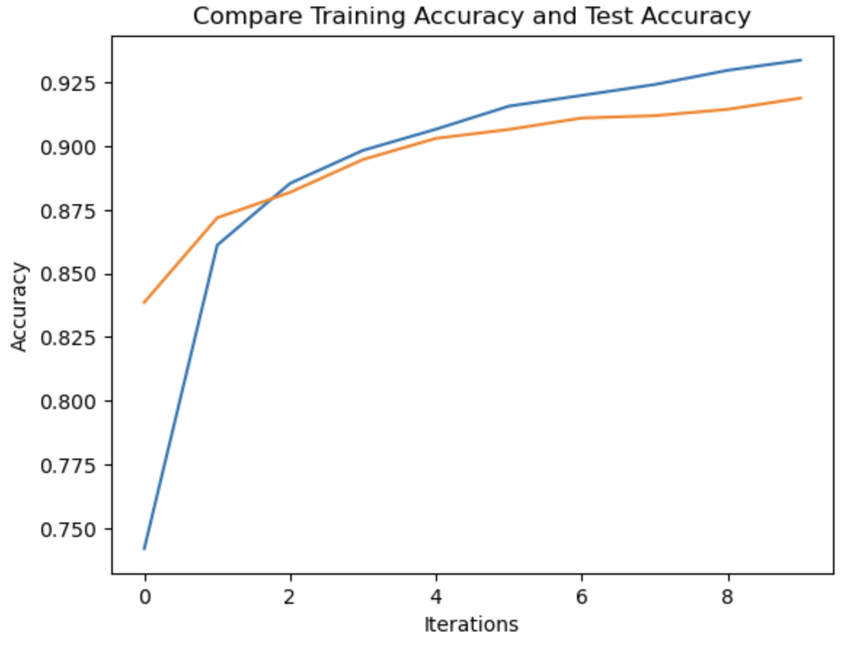
Optimizer

Slide 65
AlexNet
Eight layers make up the architecture: five convolutional layers and three fully-connected layers.
The AlexNet model is extremely powerful and capable of achieving high accuracy on challenging datasets.
AlexNet's performance will drastically suffer if any of the convolutional layers are removed.
AlexNet is a leading architecture for any object-detection task.

Slide 66
AlexNet
Model:
Optimizer = adam
loss='categorical_crossentropy'
activation='relu'
activation = 'softmax' (Ouput Dense layer)
Dropout = 0.5
Poolsize = 3 for MaxPooling2D
Accuracy on test data: 80.31%%

Slide 67
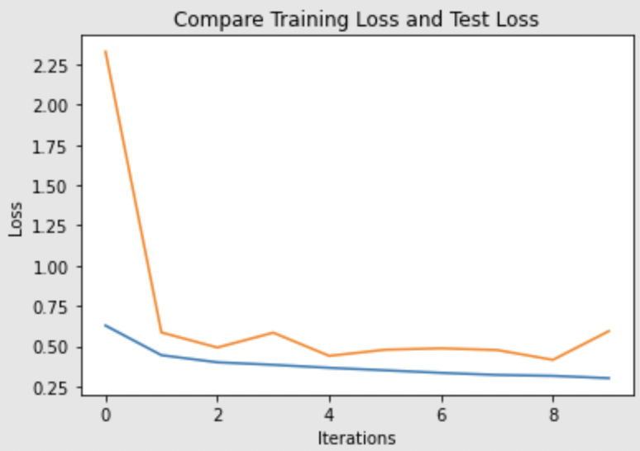
AlexNet

Slide 68
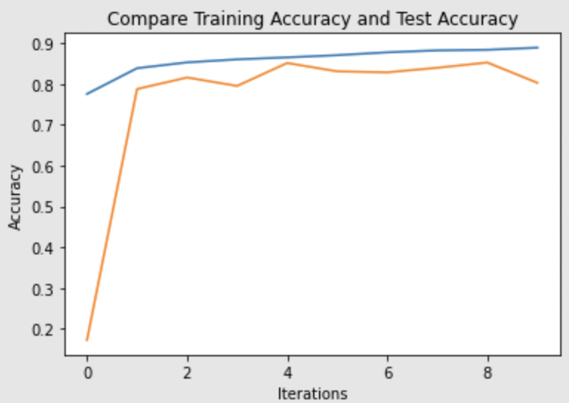
AlexNet

Slide 69
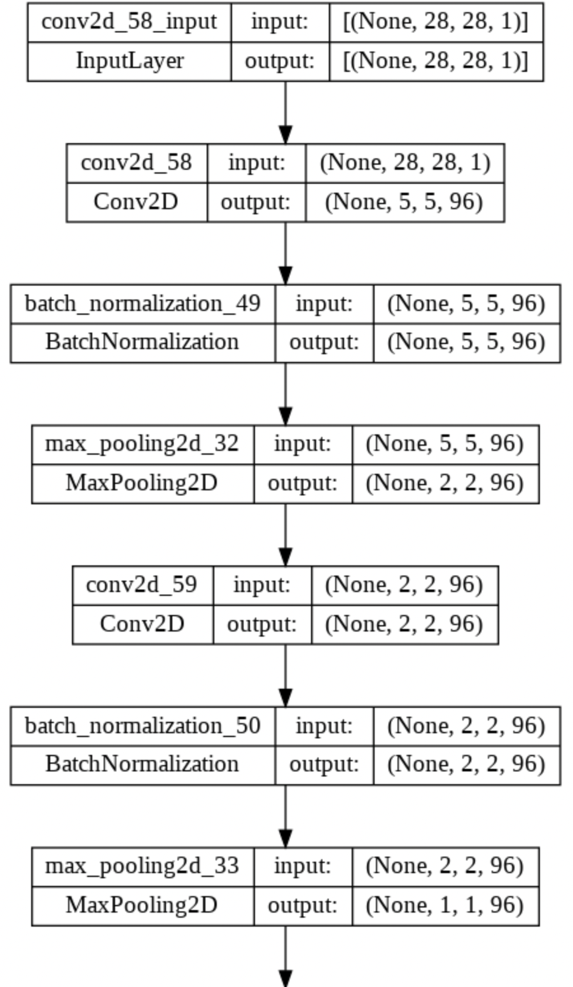
Alenet Model

Slide 70
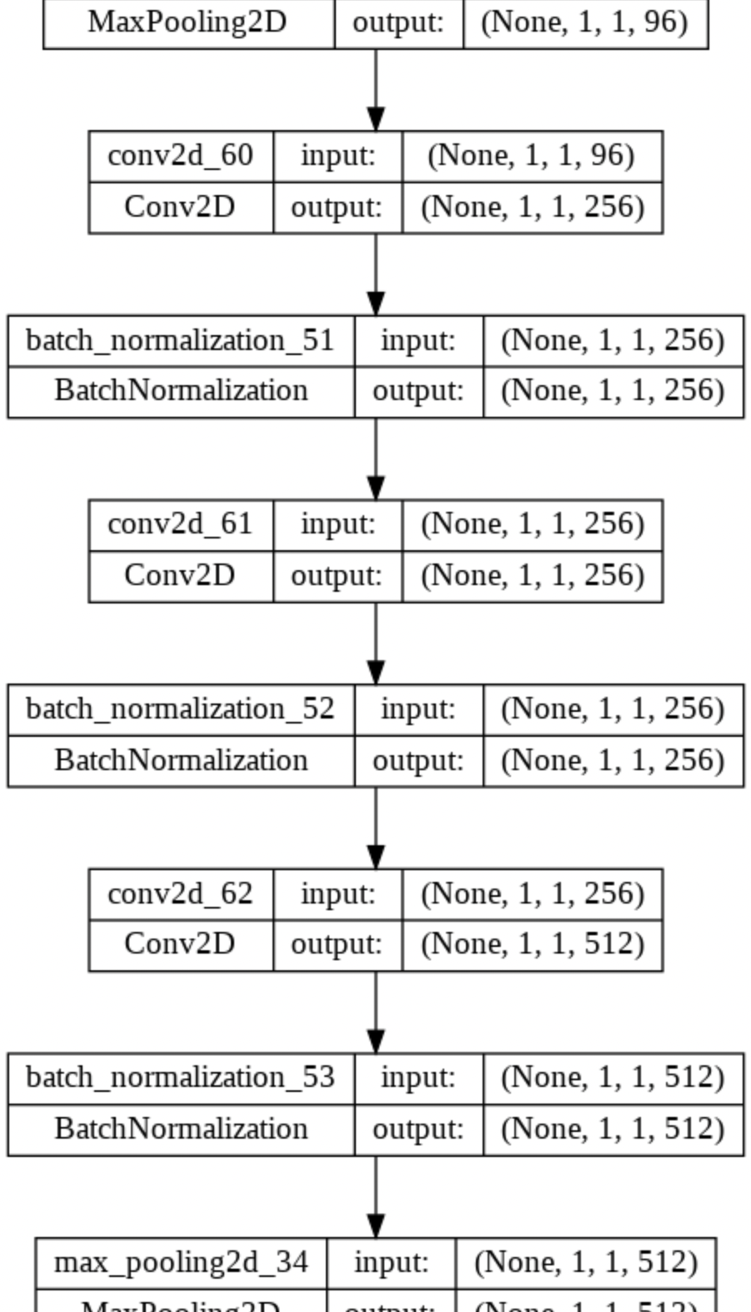
AlexNet model

Slide 71
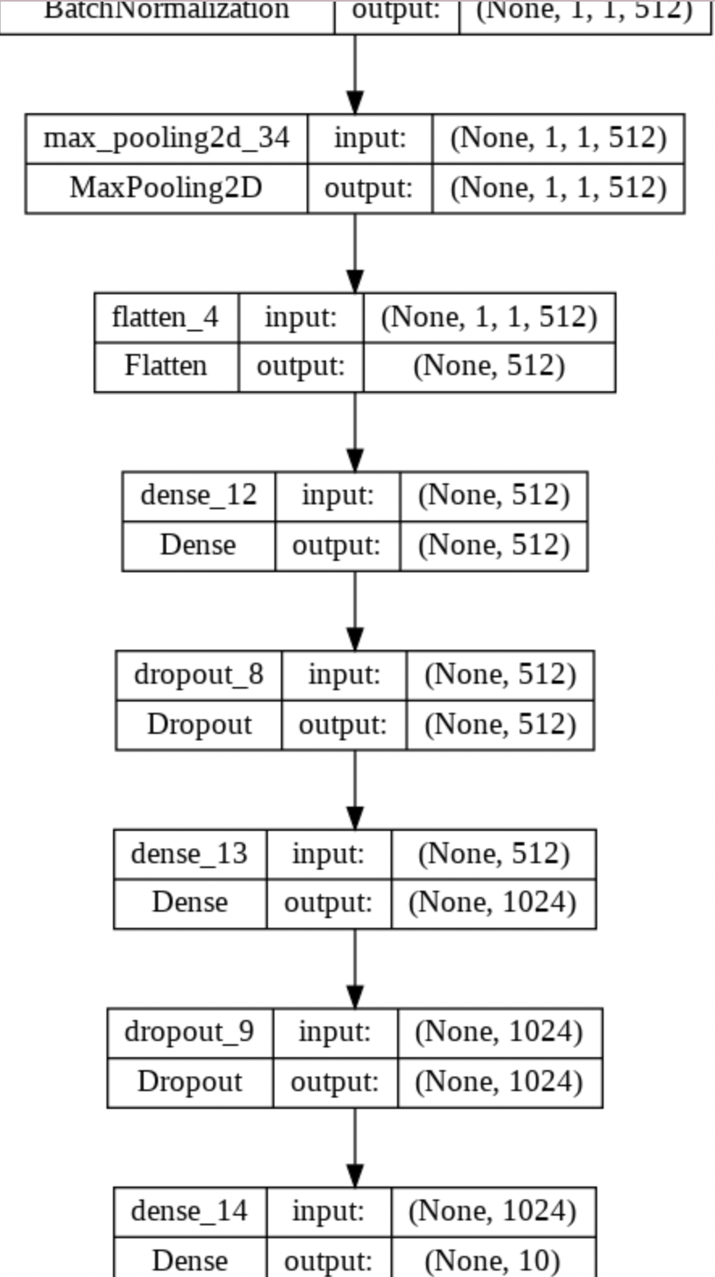
AlexNet Model

Slide 72
LeNet Model
On a high level, LeNet (LeNet-5) is composed of two components:
(i) A convolutional encoder with two convolutional layers.
(ii) A dense block with three fully connected layers.
The units in every convolutional block are a convolutional layer, a sigmoid activation function, and an average pooling operation.
A 5×5 kernel and a sigmoid activation function are used by each convolutional layer.

Slide 73
LeNet Model
Model:
Activation = 'relu'
Activation = 'softmax' for Dense Output Layer
Optimizer = 'adam'
loss='categorical_crossentropy'
Epoch = 10
Batch size = 10000
Accuracy:
The accuracy of test data is 74.82%.

Slide 74
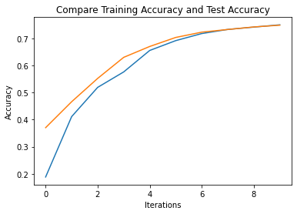
LeNet

Slide 75
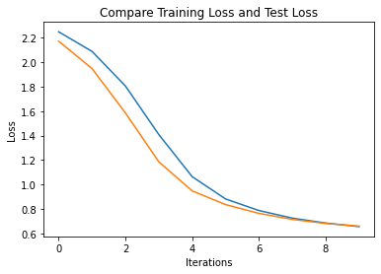
LeNet

Slide 76
LeNet Model
Model:
Activation = 'relu'
Activation = 'softmax' for Dense Output Layer
Optimizer = 'adam'
loss='categorical_crossentropy'
Epoch = 10
Batch size = 6000
Accuracy:
The accuracy of test data is 78.05%.

Slide 77
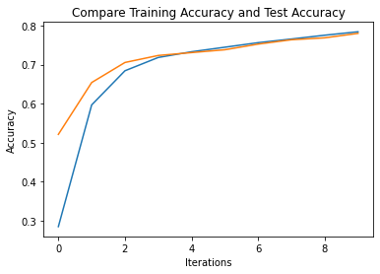
LeNet

Slide 78
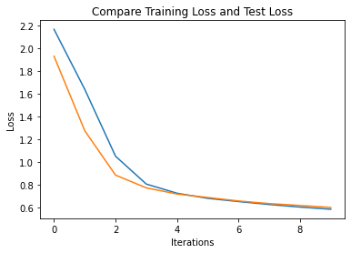
LeNet

Slide 79
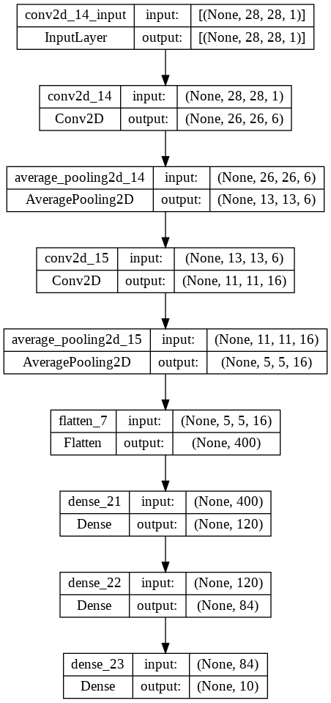
LeNet Model

Slide 80
RNN
A recurrent neural network (RNN) is an artificial neural network using sequential data or time series data.
Recurrent neural networks learns from training data.
As they are able to use information from prior inputs to influence the current input and output, they are distinguished by their "memory." Recurrent neural networks produce outputs based on previous elements within the sequence, unlike traditional deep neural networks, which assume inputs and outputs are independent of each other.

Slide 81
VGG-16
VGG-16( Visual Geometry Group) is a convolutional neural network that is 16 layers deep.
VGG16 would be able to classify images of different types.
It is a huge network with a total of nearly138 million parameters.
A test accuracy of 91.69% was obtained using VGG-16 as the model on the dataset.

Slide 82
VGG-16
Model:
Activation = 'relu'
Activation = 'softmax' for Dense Output layer
Optimizer = 'adam'
loss = 'categorical_crossentropy'
Epochs = 10
Batch_size = 256
min_lr = 0.00001

Slide 83
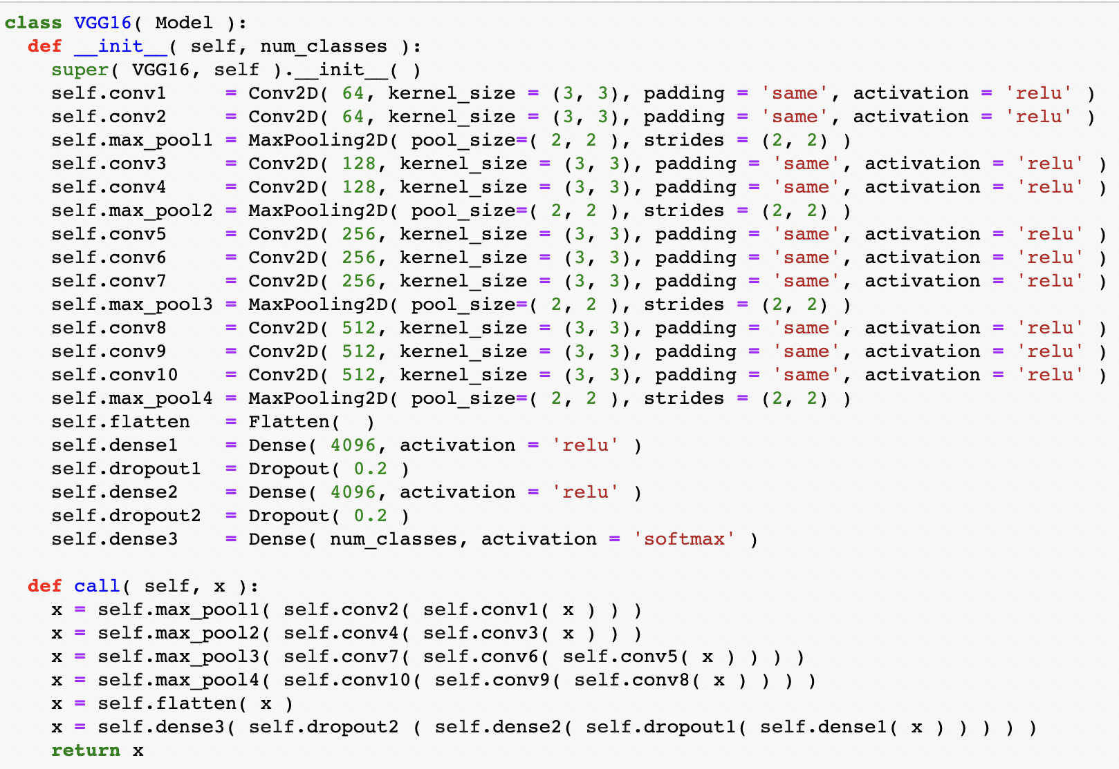
VGG-16 Model

Slide 84
RNN
Due to its internal memory, it's the first algorithm that remembers its input, making it ideal for ML problems that involve sequential data.
The information in a RNN is cycled through a loop. It considers both the current input and what it has learned from previous inputs when making a decision.
A typical RNN has a short-term memory. Along with an LSTM they can have a long-term memory.

Slide 85

RNN Model

Slide 86
RNN Model
Layers:
LSTM(128) ; Activation = 'relu'
Dropout(0.2)
LSTM(128) ; Activation = 'relu'
Dropout(0.2)
Dense(32); Activation = 'relu'
Dropout(0.2)
Dense(10); Activation = 'softmax'
Optimizer = 'Adam' ; lr=1e-3, decay=1e-5

Slide 87
RNN Model
Model:
Epoch = 10
loss='sparse_categorical_crossentropy'
Dropout = 0.2
test loss: 0.2994
test accuracy: 0.9007

Slide 88

RNN Model

Slide 89

RNN Model

Slide 90
RNN Model
Layers:
LSTM(128) ; Activation = 'relu'
Dropout(0.5)
LSTM(128) ; Activation = 'relu'
Dropout(0.5)
Dense(32); Activation = 'relu'
Dropout(0.5)
Dense(10); Activation = 'softmax'
Optimizer = 'Adam' ; lr=1e-3, decay=1e-5

Slide 91
RNN Model
Model:
Epoch = 10
loss='sparse_categorical_crossentropy'
Dropout = 0.5
test loss: 0.3543
test accuracy: 0.8716

Slide 92

RNN Model

Slide 93

RNN Model

Slide 94
RNN Model
Layers:
LSTM(128) ; Activation = 'relu'
Dropout(0.5)
LSTM(128) ; Activation = 'relu'
Dropout(0.5)
Dense(32); Activation = 'relu'
Dropout(0.5)
Dense(10); Activation = 'softmax'
Optimizer = 'Adam' ; lr=1e-4, decay=1e-5

Slide 95
RNN Model
Model:
Epoch = 10
loss='sparse_categorical_crossentropy'
Dropout = 0.5
test loss: 0.3645
test accuracy: 0.8658

Slide 96

RNN Model

Slide 97

RNN Model

Slide 98
State-of-the-art algorithms Comparision
Model | Test Accuracy
CNN | 91.89
AlexNet | 80.31
LeNet | 78.05
PCA + KNN | 83.19
Neural Network | 89.66
VGG16 | 91.69
RNN | 90.07

Slide 99

State-of-the-art algorithms Comparision

Slide 100
State-of-the-art algorithms Comparision
We can see that the CNN test accuracy is 91.89%.
VGG 16 did better next with a test accuracy of 91.69%
RNN accounts to a test accuracy of 90% nearly .
The basic neural network gives a test accuracy of 89.6%.
PCA (Dimensionality reduction) along with KNN gives a test accuracy of 83.19%.
AlexNet's test accuracy is 80.31%.
LeNet has a least test accuracy of 78.05%.

